Slide 1



Closer Academy – Advanced Python and GIT
April 2024

Slide 2
Closer Academy – Advanced Python
April 2024

Slide 3
What to expect from this class?
Functions
Big-O Notation
Object Oriented Programming
IDEs and GIT

Slide 4
Functions

Slide 5


Functions
Functions in Python - blocks of instructions that have a purpose or fulfill a specific task. Useful to reuse code.
Some of the benefits of using functions are:
- Increasing code readability
- Increasing code reusability
There are two types of functions
Built-in functions
User-defined functions

Slide 6
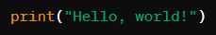
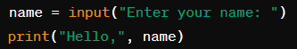
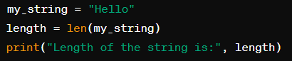
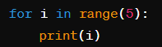
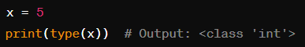
Built-in functions
print():
Used to print the specified message to the screen, or other standard output (stout) devices.
input():
Used to take input from the user through the console.
len():
This function returns the length of an object, such as a string, list, tuple, or dictionary.
range():
Generates a sequence of numbers within a specified range. Starts in zero
type():
Returns the type of an object.

Slide 7
User-defined Functions
2. Next add the function name
1. Start with the keyword def (for define)
3. Use “( )”
def print_hello_world():
"""
This function prints “Hello world”.
"""
print(“Hello world”)
4. End with “:”
!! IMPORTANT !!
Indent and line up all statements inside your function
5. Optional but highly recommended: Add docstrings to describe the function
6. Add the statement(s) that do the task of the function

Slide 8
User-defined Functions
2. Next add the function name
1. Start with the keyword def (for define)
3. Declare input parameters (arguments) inside “()”
def add2nums(num1, num2):
"""
This function adds two numbers.
Args:
- num1: The first number.
- num2: The second number.
Returns:
- sum: The sum of num1 and num2.
"""
sum = num1 + num2
return sum
4. End with “:”
!! IMPORTANT !!
Indent and line up all statements inside your function
5. Optional but highly recommended: Add docstrings to describe the function
6. Add the statement(s) that do the task of the function
7. Optional: Add the keyword “return” to return any outcome(s)

Slide 9
Functions – calling
def print_hello_world():
"""
This function prints “Hello world”.
"""
print(“Hello world”)
def add2nums(num1, num2):
"""
This function adds two numbers.
Args:
- num1: The first number.
- num2: The second number.
Returns:
The sum of num1 and num2.
"""
sum = num1 + num2
return sum
(Sum will have the value 12)
Function Calling:
print_hello_world()
“Hello world”
Call the function by using its’ name followed by “()” containing parameters of that function.
Function Calling:
sum = add2nums(2, 10)
(Sum will have the value 12)

Slide 10
Types of Function Arguments
In Python, function arguments are the values or variables passed to a function or method when calling it. These arguments are used to specify the parameters of the function or method. In Python, there are the following types of arguments for functions:
- Positional arguments
- Keyword arguments
- Default or optional arguments
- Arbitrary arguments (variable-length arguments *args and **kwargs)

Slide 11
Positional Arguments
Positional arguments are passed to a function based on their position. They rely on the order in which they are provided.
If a user accidentally switches the positional arguments, the function will interpret the arguments in the wrong order.
Example:
def introduce(name, age):
"""
This function prints an introduction.
"""
print("Hello, my name is", name, "and I am", age, "years old.")
introduce(“Alice”, 25)
# Output: Hello, my name is Alice and I am 25 years old.
introduce(25, “Alice”)
# Output: Hello, my name is 25 and I am Alice years old.

Slide 12
Keyword Arguments
Allow you to specify arguments by their parameter names when calling a function. This way, you can provide arguments out of order or omit some arguments if you know their default values.
Example:
def greeting(name, greeting):
"""
This function prints a greeting.
"""
print(greeting, name)
greeting(greeting=“Olá”, name=“Alice”)
# Output: Hello Alice
greeting(name=“Alice”, greeting=“Olá”)
# Output: Hello Alice
Note: The result of the function will be the same because we are passing the same values for each parameter of the function.

Slide 13
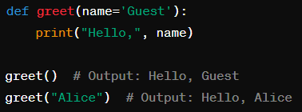
Default Arguments
Parameters in a function that have a default value assigned to them. If the function is called without passing a value for these parameters, the default value is used.
Example:
Note: One can only call a function without parameters (e.g., greet()) when all the arguments of the function are predefined or when the function does not require parameters.

Slide 14
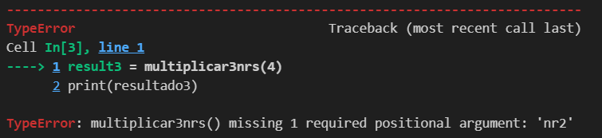
Arguments
A function should be called with the correct number of arguments. This means that if the function has two arguments, we should call the function with two arguments and neither more nor less (unless arguments are already predefined - in which case the predefined value is used if not directly specified).
def multiply_3_numbers(nr1, nr2, nr3=3):
"""This function multiplies three numbers (nr1, nr2, nr3)."""
return nr1 * nr2 * nr3
result1 = multiply_3_numbers(2, 4)
print(result1)
# Output: 24
result2 = multiply_3_numbers(2, 4, 4)
print(result2)
# Output: 32
result3 = multiply_3_numbers(4)
print(result3)

Slide 15
*Args - Variable-length non-keyword arguments
*Args: are used to pass a variable number of non-keyword arguments to a function - they act as an iterable.
def multiply_numbers(*args):
"""This function multiplies number(s) passed as argument(s).""“
total = 1
for num in args:
total *= num
return total
result = multiply_numbers(1, 2, 3, 4, 5)
print(result) # Output: 120
numbers = (1, 2, 3, 4, 5)
print(multiply_numbers(*numbers))
*args allows the function multiply_nrs() to accept any number of non-keyword arguments, and these are treated as an iterable within the function. Alternatively, you can pass an iterable, preceded by *.
Notes:
Em Python podemos criar funções que aceitam um número de argumentos variável.
Isto é conseguido quando se usa *args e **kwargs.

Slide 16
**Kwargs – Argumentos com palavra-chave de comprimento variável
**Kwargs: is used to pass a variable number of keyword arguments. It acts like a dictionary, mapping each keyword to its respective value.
When **kwargs are printed, the arguments are not printed in a specific order (just like in a dictionary).
def print_info(**kwargs):
"""This function prints information."""
for key, value in kwargs.items():
print(f"{key} = {value}")
print_info(first_name="Catarina", last_name="Gouveia")
# Output: first_name = Catarina
# last_name = Gouveia
info = {"first name": "Catarina", "last name": "Gouveia"} print_info(**info)
# Output: first name = Catarina
# last name = Gouveia
**kwargs allows the function print_info() to accept any number of keyword arguments, and these are treated as dictionary within the function. Alternatively, you can pass a dictionary, preceded by **.
Notes:
*Args e **Kwargs são utilizados quando se precisa de flexibilidade no número de argumentos que são passados numa função.

Slide 17
Functions – best practices
Descriptive Function Names: A descriptive name allows intuitively understanding what the function does or what its purpose is.
Single Responsibility Principle: Each function should have a single, well-defined purpose. Complex tasks should be divided into smaller and simpler functions. This makes the code clearer, easier to read, and facilitates maintenance.
Clear, Short, and Concise Functions: Small functions are easier to read.
Document with comments and docstrings: It is important to explain the code so that other people can understand it as well (or ourselves, later).
Testing: Even if functions seem very simple, you should always try different arguments to confirm that they work as expected.

Slide 18
Comments and Docstrings
def add_numbers(a: int, b: int) -> int:
"""Adds two numbers.
Args:
a (int): The first number.
b (int): The second number.
Returns:
int: The sum of the two numbers.
Example:
>>> add_numbers(5, 3)
8
"""
# Calculate the sum
return a + b
# Invoke function
result = add_numbers(10, 5)
print(result)
# Output: 15
Starts and ends with """ (triple quotes)
Describes the function's purpose
Mentions the arguments the function receives
Mentions what the function returns (if it returns).
Optional: Examples of how to use
Additionally, descriptive comments can be added, which start with "#"

Slide 19
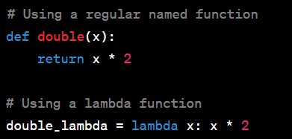
Lambda Functions
Lambda functions, also known as anonymous functions or lambda expressions, are a compact way to define small, simple functions in Python.
2. Followed by one or more parameters (if more than one, separated by “,”) and no parentheses
4. And an expression – Must be a single valid Python expression
1. Start with the keyword lambda
lambda parameters: expression
3. “:” – This is a cue for the expression
Lambda functions are often used in places where a short function is needed temporarily.

Slide 20
Lambda Functions – Examples
Usage examples:
As an argument to higher-order functions like map(), and sorted()
Lambda for Simple Calculations
words = [“strawberry", “apple", “raspberry", "banana"]
plural_words = list(map(lambda p: p + "s", words))
print(palavras_plural)
# Output: [“strawberrys", “apples", “raspberrys", "bananas"]
words = [“strawberry", “apple", “raspberry", "banana"]
sorted_words = sorted(words, key = lambda word: len(word))
print(sorted_words)
# Output: [“apple", “banana", “raspberry", “strawberry"]
add = lambda x, y: x + y
result = add(5, 3)
print(result)
# Output: 8

Slide 21

Map, filter, reduce
map()
filter()
reduce()
These functions are paradigms of functional programming. They allow to write simpler, shorter code. They allow, to apply a function across iterables without the need for loops.

Slide 22
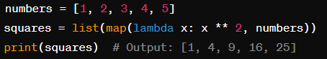
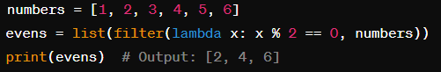
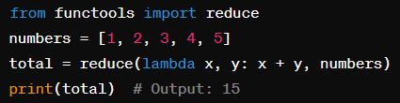
Map, filter, reduce - examples
map() – applies (maps) a function to an iterable and returns a new iterable with the respective values.
filter() - is used to filter elements from an iterable based on a condition (specified in a function) and returns a new iterable containing the filtered elements.
reduce() – from the functools module, is used to reduce the sequence of elements to a single value through continuous computation.
3
10
15
6

Slide 23
Recursive Functions
Functions that call themselves to solve a smaller instance of the same problem. They break down complex problems into smaller, more manageable sub-problems and solve each sub-problem independently. Recursive functions typically have two parts: a base case and a recursive case.
Base Case:
Simplest form of the problem that can be solved directly without further recursion.
Termination condition for the recursion
Recursive Case:
In the recursive case, the function calls itself with modified arguments to solve a smaller instance of the same problem.
Each recursive call reduces the problem size.

Slide 24
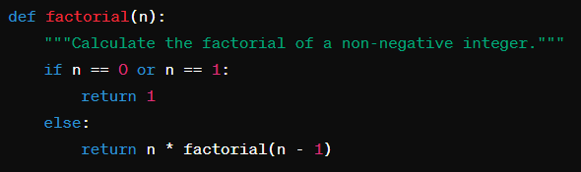
Recursive Functions
Factorial: Calculates the product of all positive integers from 1 up to a given number, inclusive. For example, the factorial of 5 (denoted as 5!) is calculated as: 5! = 5 × 4 × 3 × 2 × 1 = 120
1. Base case: The factorial of 0 or 1 is always 1.
Execution: When the function is called with a non-negative integer n, it recursively calls itself with n-1, n-2, etc. until it reaches the base case. Once it reaches the base case, the recursion stops, and the function begins returning the results back up the "call stack".
2. Recursive case: Computes the factorial of n by multiplying n with the factorial of n-1.
n! = n × (n-1) × (n-2) × ... × 2 × 1

Slide 25
Recursive Functions
Factorial: Calculates the product of all positive integers from 1 up to a given number, inclusive. For example, the factorial of 5 (denoted as 5!) is calculated as: 5! = 5 × 4 × 3 × 2 × 1 = 120
factorial(4)
4 * factorial(4-1)
3 * factorial(3-1)
2 * factorial(2-1)
factorial(1)
24
6
4 * 6 = 24
3
2
3 * 2 = 6
2
1
2 * 1 = 2
1
1

Slide 26
Recursive Functions – Advantages
What are the advantages of using recursive functions instead of normal (iterative) functions?
Simplicity of code: Recursive algorithms can be simpler and more concise than their corresponding iterative counterparts. Recursion allows expressing the solution closer to the mathematical definition of the problem, reducing the need for control variables and loop structures.
Ease of understanding: For certain types of problems, the recursive approach can be more intuitive and easier to understand.
Ease of implementation: In some cases, the recursive solution is easier to implement than the iterative solution. For example, problems involving recursive data structures such as trees are often more naturally approached recursively.
Abstraction of repetitive tasks: In problems where the same task needs to be performed repeatedly with variations in parameters, recursion can abstract this repetition, allowing the function to be called multiple times with different arguments, without the need to write separate code for each case.

Slide 27
Recursive Functions – Disadvantages
Additional memory consumption due to the recursive call stack
Potentially lower efficiency compared to iterative solutions in certain cases.
Therefore, when choosing between a recursive approach and an iterative approach, it is important to consider the nature of the problem, the efficiency of the algorithm, and the readability and ease of maintenance of the resulting code.

Slide 28
Big-O Notation

Slide 29
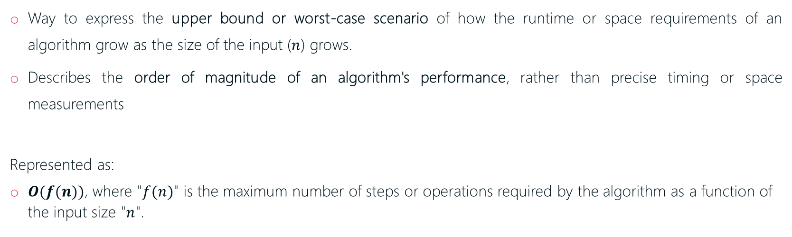
Big-O Notation
Big-O notation is a mathematical notation used to describe the time complexity (execution time) or space complexity (memory usage) of an algorithm.
Way to express the upper bound or worst-case scenario of how the runtime or space requirements of an algorithm grow as the size of the input ($n$) grows.
Describes the order of magnitude of an algorithm's performance, rather than precise timing or space measurements
Represented as:
$O(f(n))$, where "$f(n)$" is the maximum number of steps or operations required by the algorithm as a function of the input size "$n$".

Slide 30
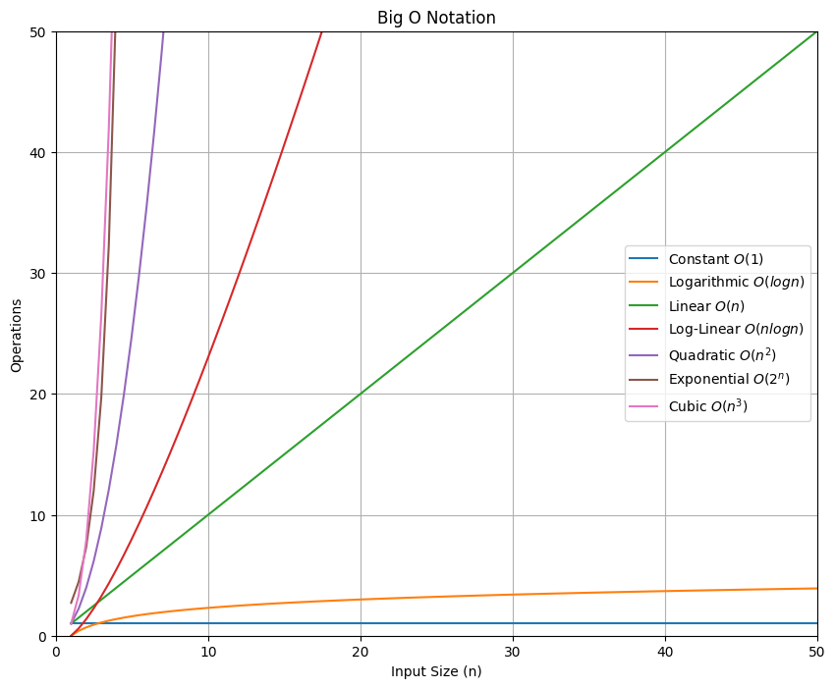
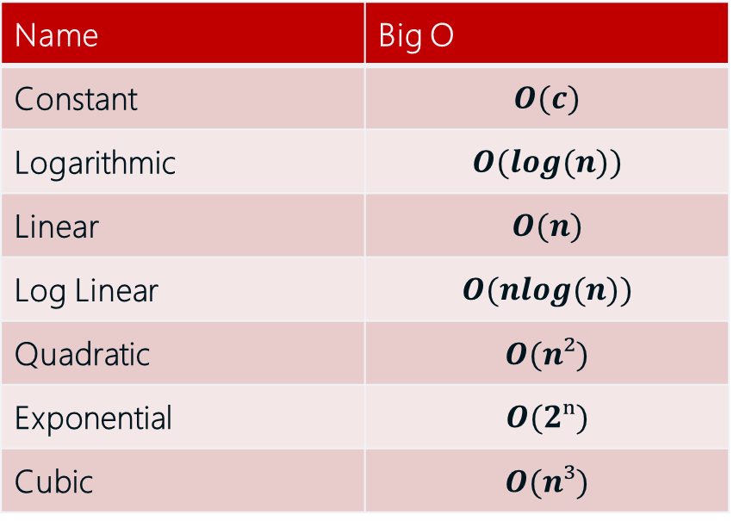
Big-O Notation
Name | Big O
Constant | $$O(c)$$
Logarithmic | $$O(log⁡(n))$$
Linear | $$O(n)$$
Log Linear | $$O(nlog(n))$$
Quadratic | $$O(n²)$$
Exponential | $$O(2ⁿ)$$
Cubic | $$O(n³)$$

Slide 31
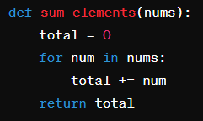
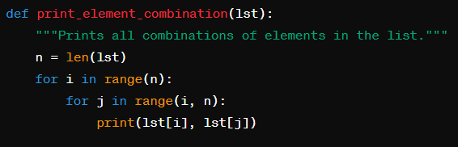
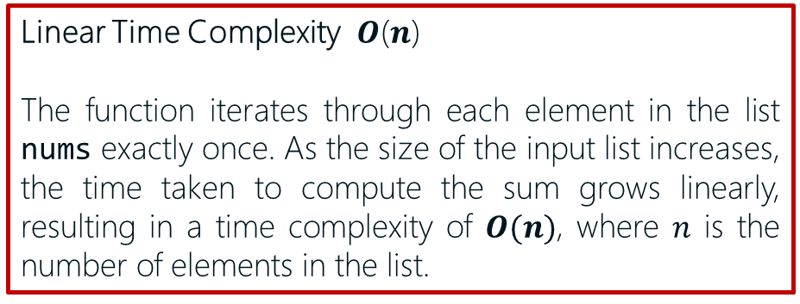
Big-O Notation – examples
In this example, the function iterates through each element in the list nums exactly once, resulting in a time complexity of O(n), where 'n' is the number of elements in the list. As the size of the input list increases, the time taken to compute the sum grows linearly.
Linear Time Complexity 𝑶(𝒏)
The function iterates through each element in the list nums exactly once. As the size of the input list increases, the time taken to compute the sum grows linearly, resulting in a time complexity of $O(n)$, where $n$ is the number of elements in the list.
Quadratic Time Complexity 𝑶(𝒏²)
The outer loop iterates 𝑛 times (where 𝑛 is the size of the list), and for each iteration of the outer loop, the inner loop also iterates 𝑛 times. This results in a total of 𝑛*𝑛 iterations ~𝑶(𝒏²). In other words, the function grows quadratically with the input size '𝑛' of the list.

Slide 32
Object Oriented Programming

Slide 33

Object Oriented Programming
Stores data
Attributes
Classes
Properties
Object Oriented Programming
(OOP)
Objects
Methods
Represent the abstract data types of your problem
Behaviors
Way of designing programs
Define actions or operations on the data
Classes can also inherit from other classes to reuse or modify their functionality.
Notes:
Object-Oriented Programming (OOP) is a way of designing programs using objects that have properties and behaviors. Python is a very versatile language that supports OOP as well as other paradigms like functional and procedural programming.
One of the main goals of OOP is data abstraction. Data abstraction refers to providing only essential information about the data to the outside world, hiding the background details or implementation.
To use OOP in Python, you need to define classes that represent the abstract data types of your problem and create objects that are instances of those classes.
Classes can have attributes that store data and methods that define actions or operations on the data. They can also inherit from other classes to reuse or modify their functionality.

Slide 34
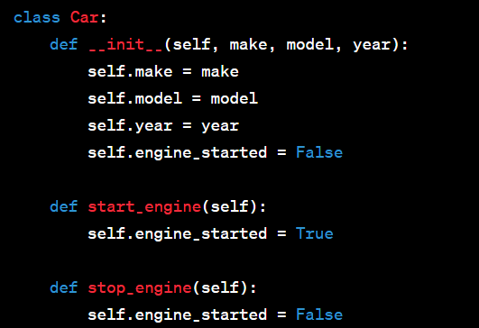
Classes
Class
A class is a blueprint or template for creating objects in object-oriented programming.
It defines the structure and behavior that the objects in the class will have.
contains
contains
Attributes
might contain
Methods
Attributes are data associated with objects of a class or a method. They store information about the state of the objects.
Attributes can be variables that hold different types of data, such as numbers, strings, or other objects.
A method is a function that allows the manipulation of an object
Methods ~ functions of a class
Attributes ~ variables of a class or method
Notes:
In other words,

Slide 35
Classes – Examples – Python
In Python, all data structures and object types are organized into classes, following the principles of Object-Oriented Programming (OOP). For example, when we print the data type of an integer using `type(5)`, we get `class 'int'`, indicating that the integer is an instance of the `int` class.
Classes in Python serve as blueprints for creating specific objects that share common characteristics and behaviors. They allow us to organize code in a more modular and reusable way.
example = [1, “a", {“blackberry“: 0}, [1, 2, 3], (2, 3, 5)]
print([type(x) for x in example])
# [<class ‘int’>, <class ‘str’>, <class ‘dict’>, <class ‘list’>, <class ‘tuple’>]

Slide 36
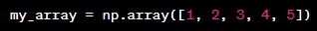
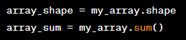
Classes – examples from Python
Example:
The NumPy library defines a class called an array;
When creating a NumPy array, we are creating an object that instantiates that class;
From a class (array), we can create multiple objects (our variables);
Arrays have associated attributes and methods

Slide 37





Classes – Examples – General
A class in Python is a data type defined by the programmer. For example, we can create a class called `Animal`. This class can contain characteristics and behaviors common to all animals. Each instance or object of the `Animal` class represents a specific animal, such as a dog, cat, etc.
When creating an instance of a class (or an object), we are creating a copy of the class with its specific characteristics and behaviors. For example, when instantiating an object of the `Animal` class to represent a dog, we can assign specific values to the dog's attributes, such as name, age, breed, etc.
Class - Animal
Objects: Dog, Cat, Whale, Squirrel

Slide 38
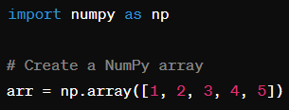
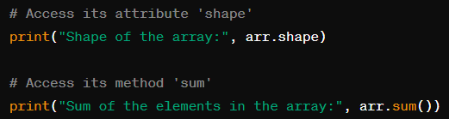
Classes – Examples – NumPy
Example:
The NumPy library defines a class called array.
When creating a NumPy array, we are creating an object that instantiates this class.
From a class (array), we can create multiple objects (variables).
Arrays have associated attributes and methods.

Slide 39

Defined Class – Example: Person
Class
Objects
Name: Jess
Age: 33
Object’s attributes
Person
Profession: Engineer
Person1
Work(): Jess works as an Engineer
Object’s methods
States
Name
Age
Name: Edward
Age: 47
Object’s attributes
Profession
Person2
Profession: Engineer
Behaviours
Work(): Edward works as an Engineer
Object’s methods
Work()
An object is an instance of a class. The object of a class is used to perform actions.

Slide 40
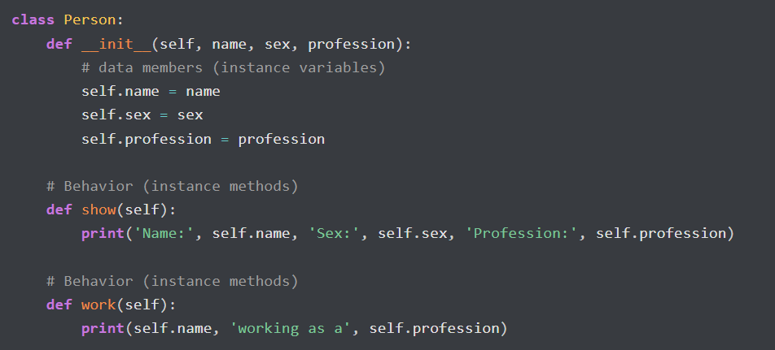
Class – Person
Class
Objects
Name: Jess
Age: 33
Person
Profession: Engineer
Person1
States
Work(): Jess works as an Engineer
Name
Age
Name: Edward
Profession
Age: 47
Person2
Profession: Engineer
Behaviours
Work(): Edward works as an Engineer
Work()
1. Always initiate a class with the keyword class followed by the name of the class and “:”
2. Add a constructor
2. A class must always have a constructor, which is used to initialize the class and always begins with "def __init__(self):". The constructor can receive parameters and initialize methods and attributes of the class.
3. Initialize object attributes
4. Methods
!! IMPORTANT !! You need to use self to bind the attributes and methods to the class

Slide 41
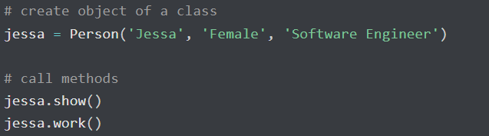
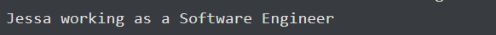
Class – Person
Class
Objects
Name: Jess
Age: 33
Person
Profession: Engineer
Person1
States
Work(): Jess works as an Engineer
Name
Age
Name: Edward
Profession
Age: 47
Person2
Profession: Engineer
Behaviours
Work(): Edward works as an Engineer
Work()
Output:

Slide 42
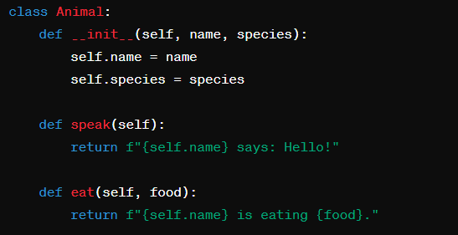
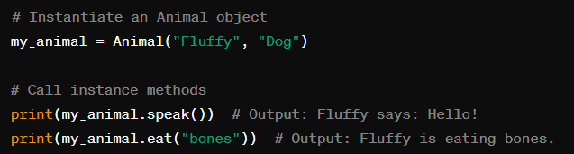
Class methods
Methods are called explicitly and are used for custom behaviors or actions within your class.

Slide 43
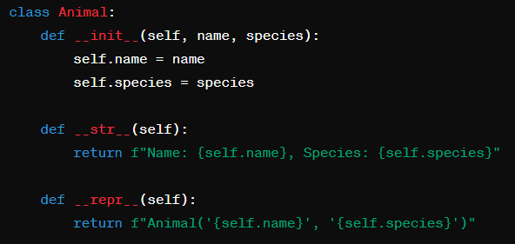
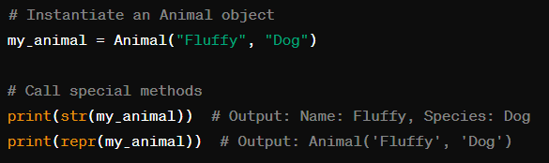
Special methods
Special methods or magic methods are automatically called by Python in response to specific operations. They are always preceded and followed by double underscores (__)

Slide 44
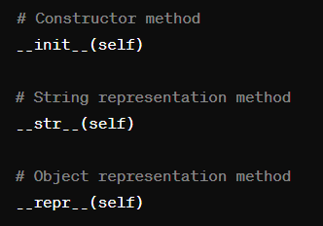
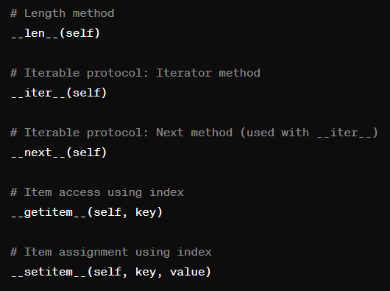
Special methods – examples
...
Notes:
Special methods, also known as magic methods in Python, are pre-defined methods that are automatically called by the Python interpreter in response to certain operations performed on objects of a class. They are called "magic" because Python automatically invokes them in specific situations, without you needing to explicitly call them.
These methods have special names that begin and end with two underscores, such as `__init__`, `__str__`, `__eq__`, among others. Each magic method has a specific purpose and is responsible for performing a particular operation or implementing a specific behavior.
For example, the `__init__` method is used to initialize an object when it is created, the `__str__` method is used to return a string representation of the object, the `__eq__` method is used to compare whether two objects are equal, among others.
These magic methods are extremely useful for customizing the behavior of your classes and making your objects more flexible and powerful. They allow you to define custom behaviors for common operations and integrate your classes more easily with the rest of the Python code.

Slide 45
Hierarchy and inheritance
Hierarchy involves creating relationships between classes to model real-world relationships, in relation to their inheritance relationships, creating a class structure with levels of abstraction and specialization. It allows for better organization of code and reuse.
Inheritance is the mechanism by which a subclass inherits attributes and methods from a base class (superclass).
The subclass can access and use the attributes and methods of the base class without needing to redefine them.
Class 1
(super-class)
Class 2
(sub-class)
Provides a general structure and behavior that subclasses can build upon.
A subclass is a class that inherits attributes and methods from a base class
It can add new attributes, methods, or override existing ones to customize the behavior defined in the base class.

Slide 46
Classes – hierarchy example
Animal
(super-class)
Dog
(sub-class)
This class can be used to create various different animals.
It will function as the base class.
Each subclass of animal (Dog in this example) is a variation of the superclass Animal and will be a more specific representation (of a Dog, in this case).
Each subclass can have its own characteristics, such as name and breed, and specific behaviors such as feeding patterns, sounds emitted, and typical activities.

Slide 47
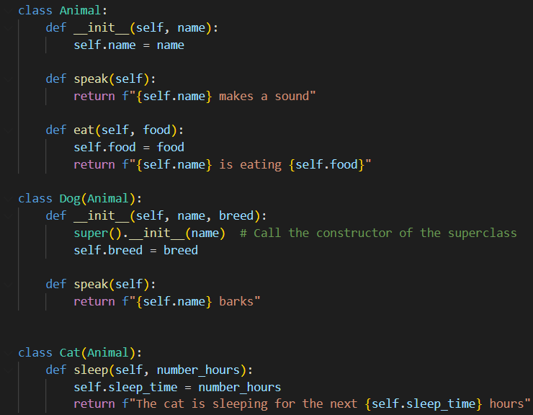
Classes – another example
1. Always initiate a class with the keyword class followed by the name of the class
2. Add a constructor
3. Initialize object attributes
Class
4. Methods
!! IMPORTANT !! You need to use self to bind the attributes and methods to the class
This is class Animal. It has an attribute called “name” which represents the name of the animal and two methods: speak and eat.
The “speak” method represents the action of the animal making a sound.
The “eat” method simulates the animal consuming food. This method requires an additional attribute called “food”, which specifies the type of food the animal is consuming.

Slide 48
Hierarchy and inheritance - example
!! IMPORTANT !! You need to use self to bind the attributes and methods to their respective class
Super class
To initiate a subclass, pass the super class as an argument
Adds a new method, exclusive to Cats
sub classe
Adds a new attribute, exclusive to Dogs
sub classe
Overrides the speak method – exclusive to Dog’s class

Slide 49
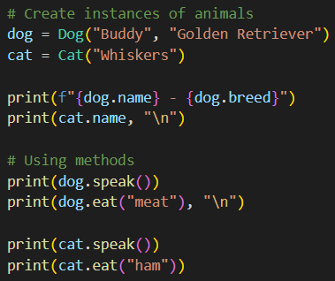
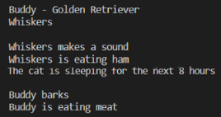
Classes – How to call attributes and methods
Use dots.
If it is a method add ()
If methods have required attributes, pass them
Output:

Slide 50
Classes – why to use them
Modularity and Organization:
- Classes promote modular organization by dividing complex systems into smaller components that are easier to manage.
- Functions and data are grouped within a class, making it easier to understand and maintain the code.
- Reusability and code scalability: classes can be instantiated and reused in different parts of the program.
Encapsulation of State:
- Classes encapsulate both data (attributes) and behavior (methods), providing a convenient way to manage the state of objects.
- This helps in maintaining the integrity of data and ensures that operations on the object's state are performed consistently.
- With classes, mechanisms of access control (e.g., public, private, protected) can be defined to restrict direct access to certain attributes, promoting better data encapsulation and avoiding unintended modifications.

Slide 51
Classes – why to use them
Inheritance:
- Classes allow inheriting from other classes, enabling the creation of new classes based on existing classes.
- Inheritance enables code reuse by inheriting attributes and methods from superclasses (parents), reducing redundancy and promoting the DRY principle (Don't Repeat Yourself).
Polymorphism:
- Polymorphism allows objects of different classes to be treated as objects of a common superclass.
- Flexibility and extensibility in the code: functions and methods that operate on objects of a superclass type can be used with objects of any subclass as well.

Slide 52
Classes – why to use them
In summary:
Abstraction
Code organization
Modularity
Reuse
Maintenance
More control

Slide 53
What we covered in this lesson
Functions
Built-in functions
User-defined functions
Lambda expressions
Recursive functions
Big-O notation
Object-Oriented Programming
Classes - objects and methods
Hierarchy

